Slide 1
TITLE ANALYSIS OF RENTAL PATTERNS AND FILM POPULARITY
NAME- Shriyansh s Mishra
Batch- ds46
STUDENTID- S9960

Slide 2
Index
INTRODUCTION
tASK
DATA COLLECTION (SQL AND EXCEL)
KEY FINDINGS
CONCLUSION

Slide 3
INTRODUCTION
Project background - Analyzing rental trends, film popularity, and store performance for mavenmovies database
Objective – Identify key patterns in rentals, determine top films, and assess store performance
Data source – mavenmovies sakila database
Methodology – data extraction via sql; analysis and visualization in excel

Slide 4
Task 1- Rental Trends
TASK 1.1- Analyze the monthly rental trends over the available data period.
TASK 1.2- Determine the peak rental hours in a day based on rental transactions.

Slide 5
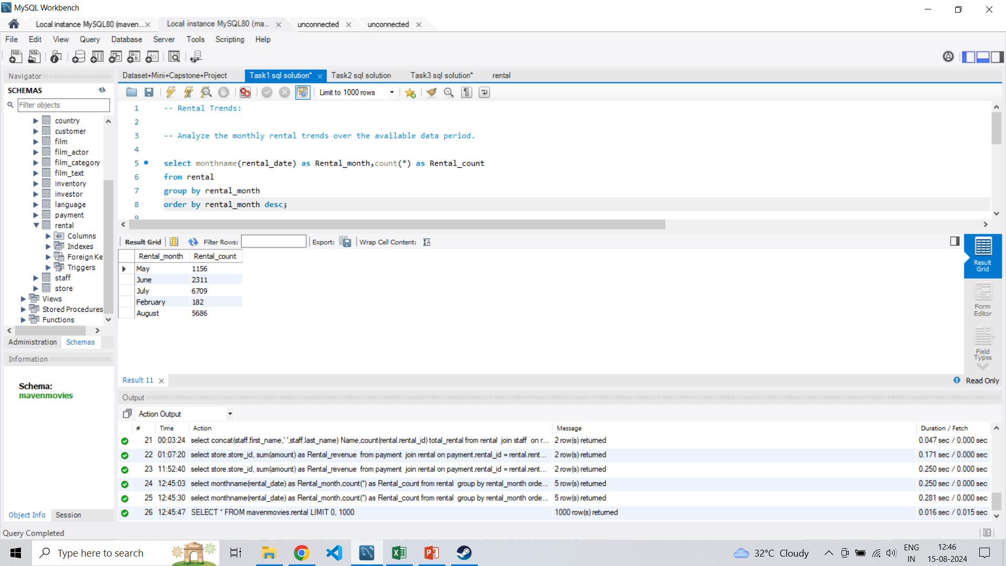
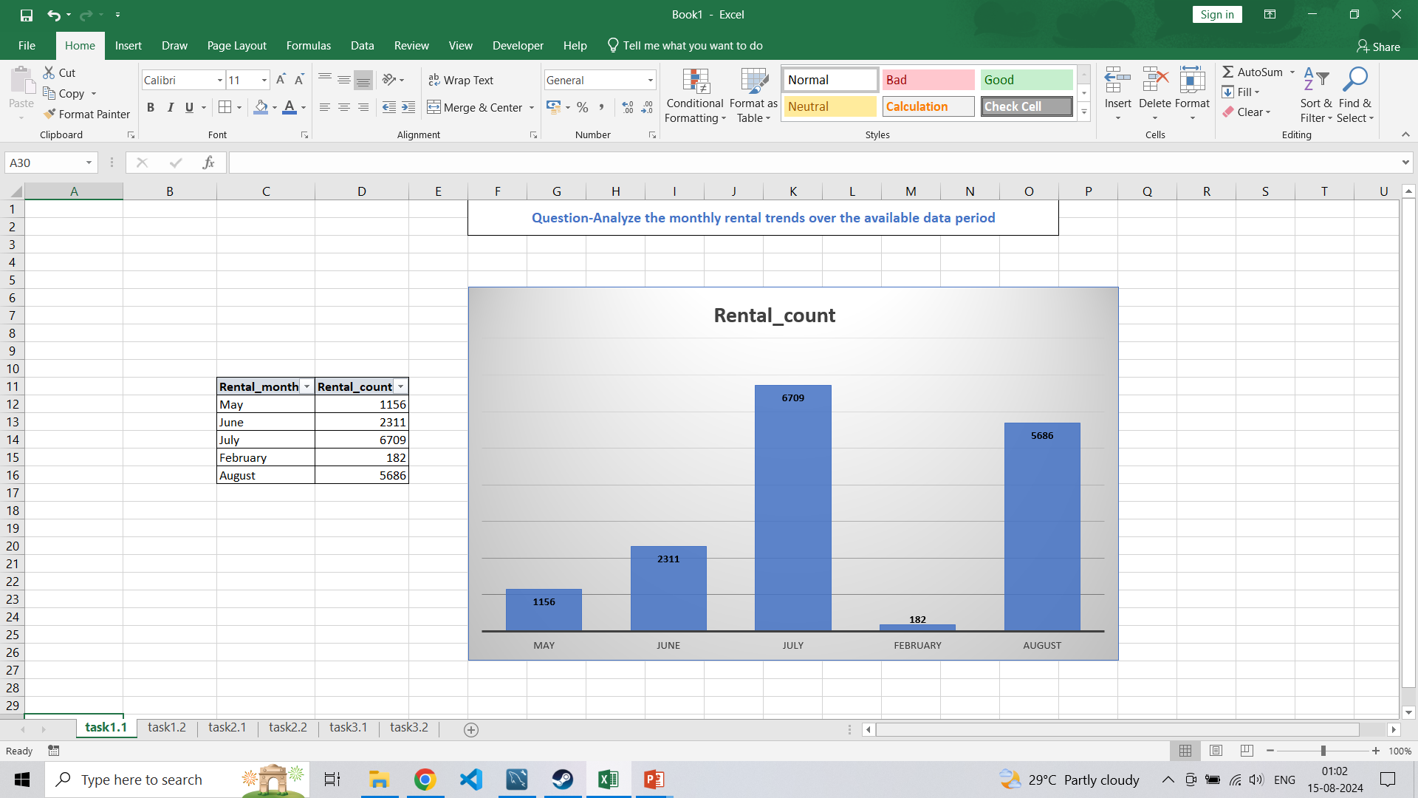
TASK 1.1 - Analyze the monthly rental trends over the available data period. SQL QUREY VISUAL REPRSENTATION

Slide 6
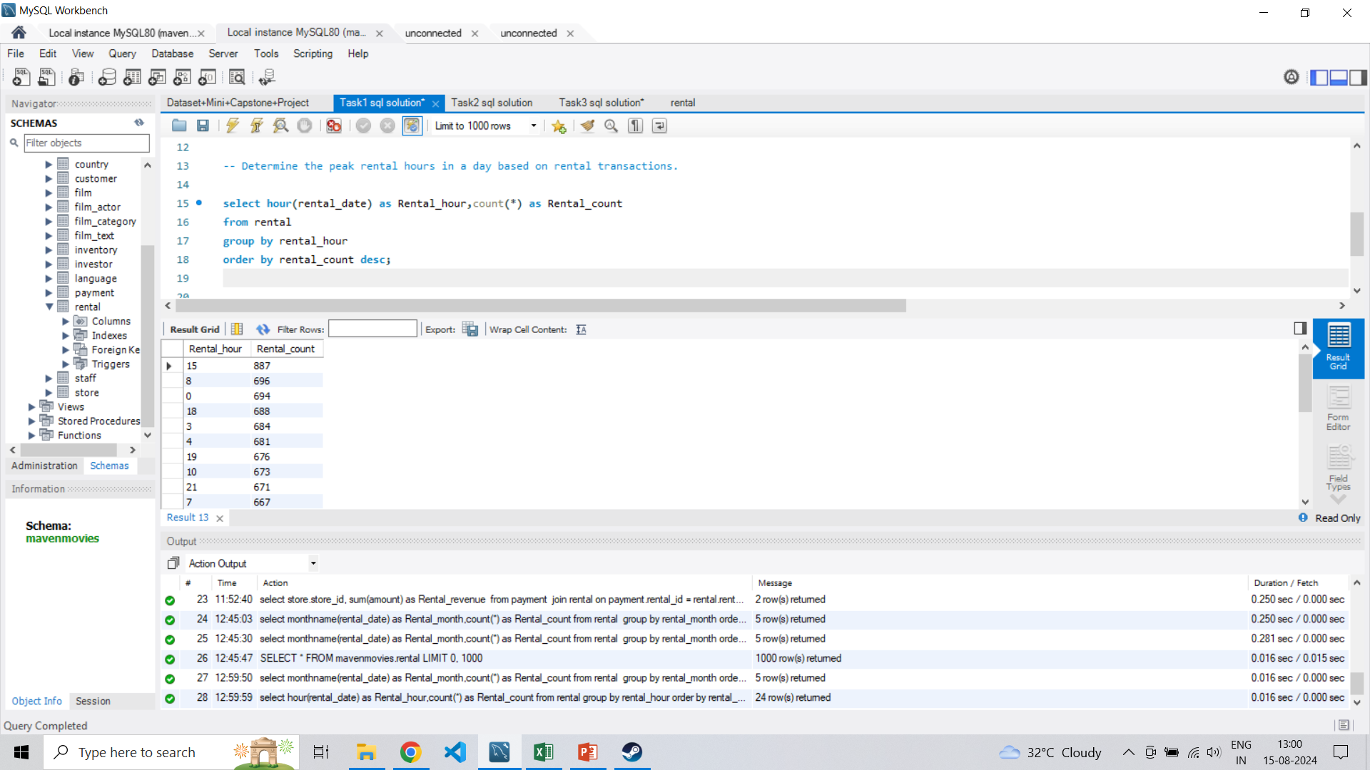
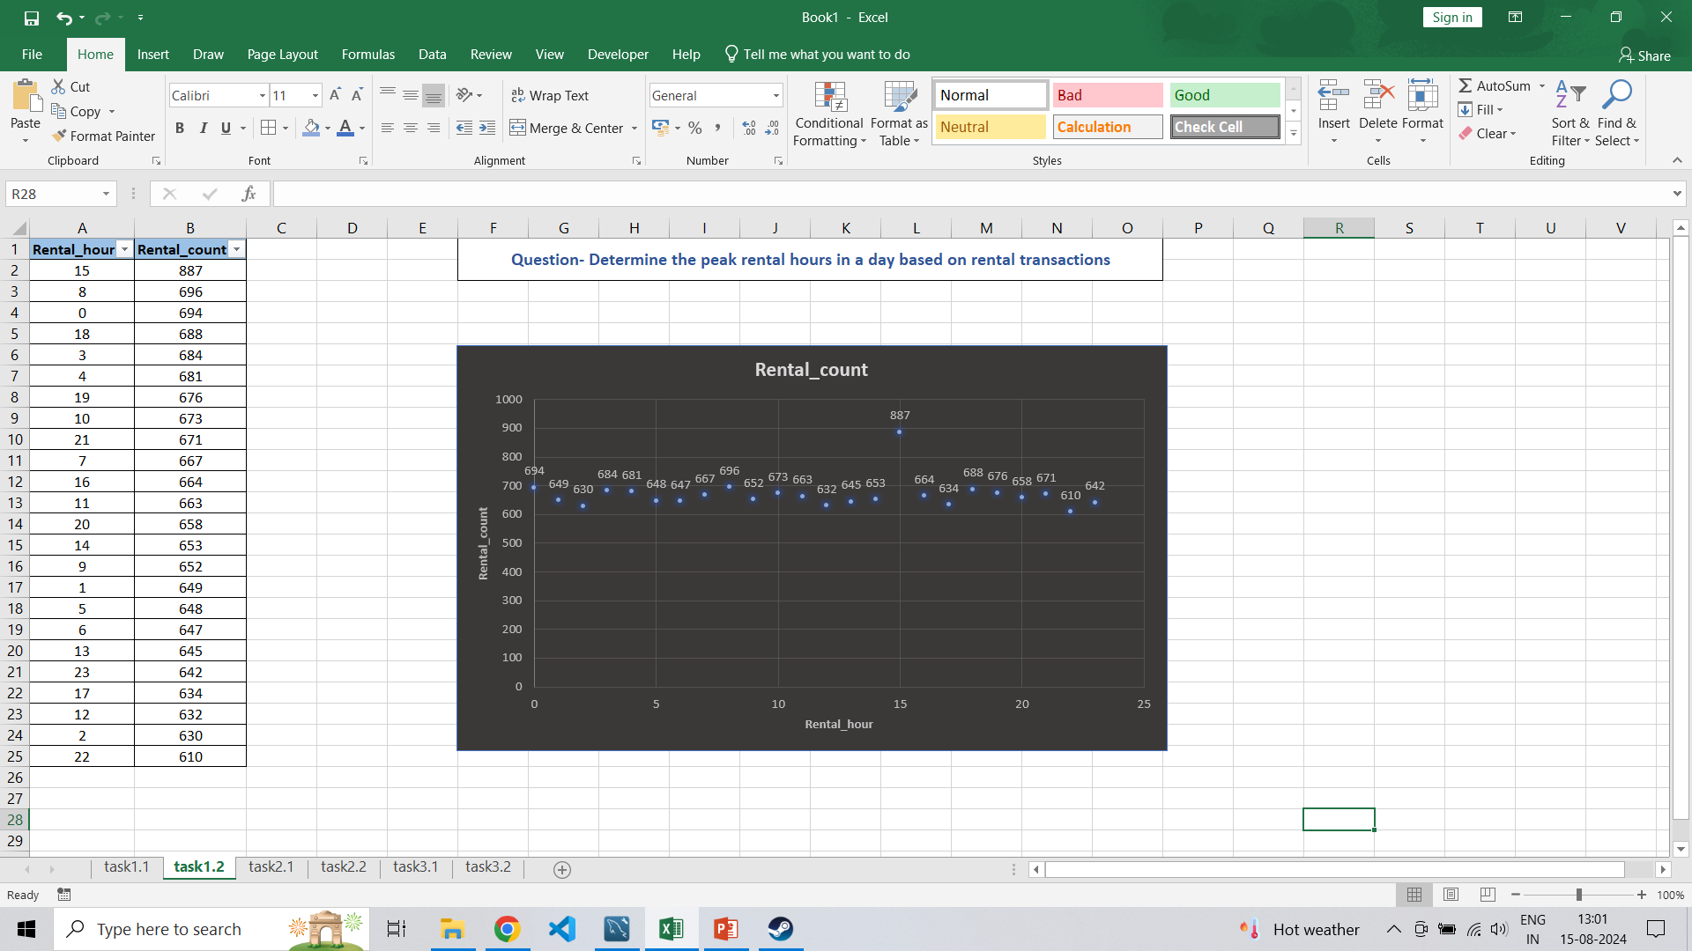
TASK 1.2 - Determine the peak rental hours in a day based on rental transactions. SQL QUERY VISUAL REPRESENTATION

Slide 7
KEY FINDINGS
PEEK RENTAL TIMES: THE MAJORITY OF RENTALS OCCUR at 3 pm and then at 8 am
SEASONAL TRENDS: RENTAL ACTIVITY IS HIGHEST IN July AND august, SUGGESTING INCREASED DEMAND DURING MONSOON SEASON

Slide 8
TASK 2- FILM POPULARITY
TASK 2.1- Identify the top 10 most rented films
TASK 2.2 - Determine which film categories have the highest number of rentals.

Slide 9
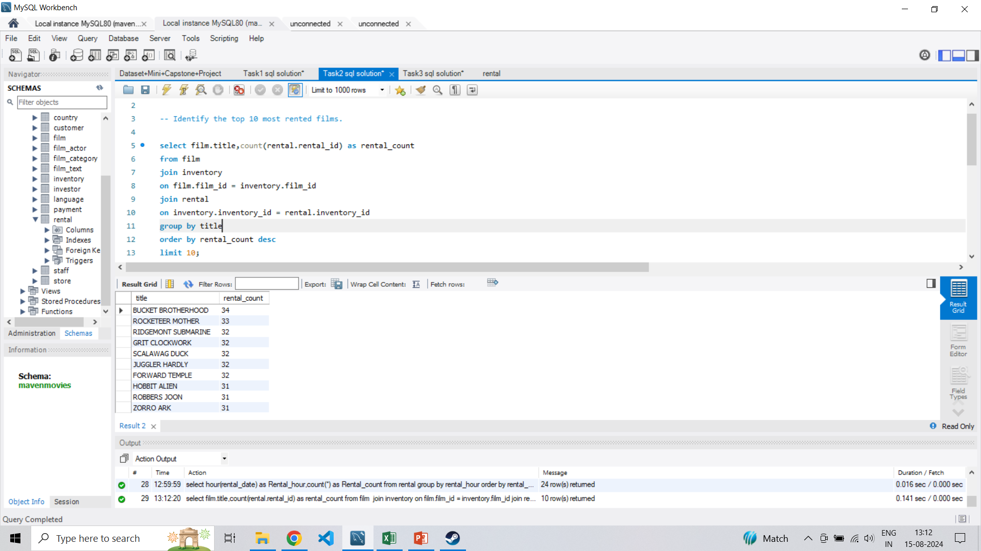
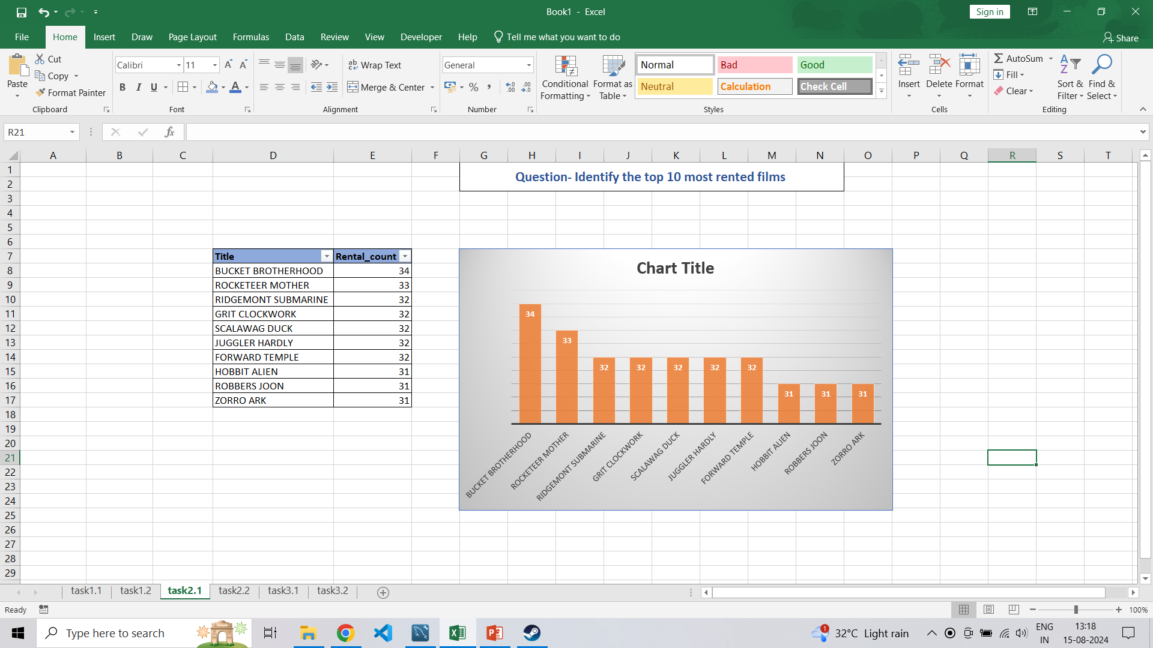
TASK 2.1 - Identify the top 10 most rented films. SQL QUERY VISUAL REPRESENTATION

Slide 10
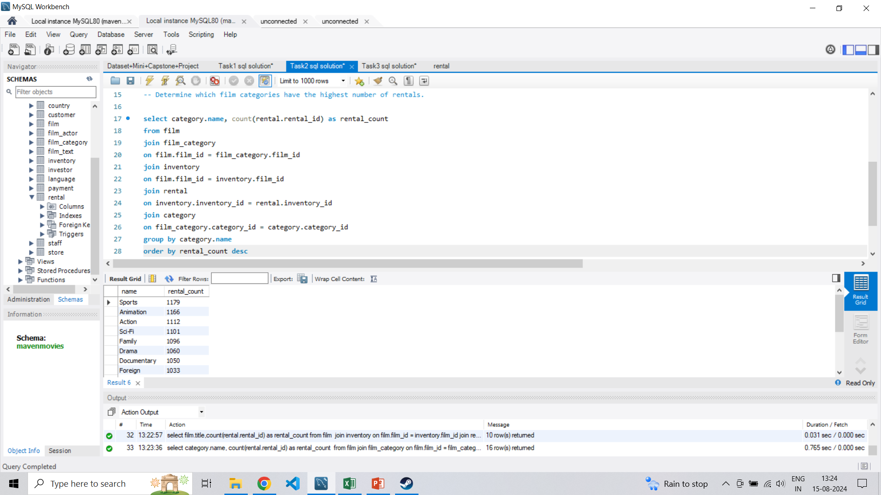
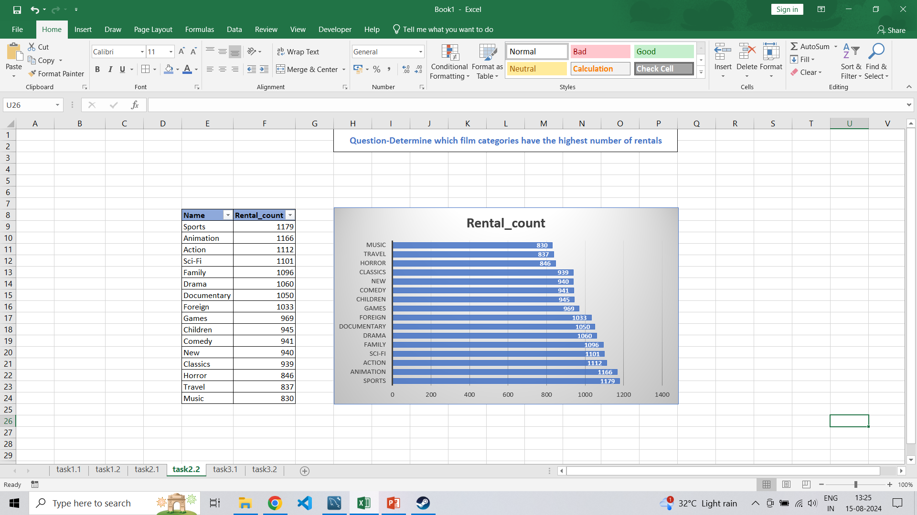
TASK 2.2 - Determine which film categories have the highest number of rentals. SQL QUERY VISUAL REPRESENTATION

Slide 11
KEY FINDINGS
FILM CATEGORIES: SPORTS,ANIMATION AND ACTION ARE THE TOP 3 FILM CATEGORIES WITH THE HIGHEST NUMBER OF RENTALS, SPORTS LEADING AT 1,179 RENTALS.
TOP RENTED FILMS: “BUCKET BROTHERHOOD” IS THE MOST RENTED FILM WITH 34 RENTALS, FOLLOWED CLOSELY BY “ROCKETEER MOTHER” WITH 33 RENTALS.

Slide 12
TASK 3- STORE PERFORMANCE
TASK 3.1- Identify which store generates the highest rental revenue.
TASK 3.2 - Determine the distribution of rentals by staff members to assess performance.

Slide 13
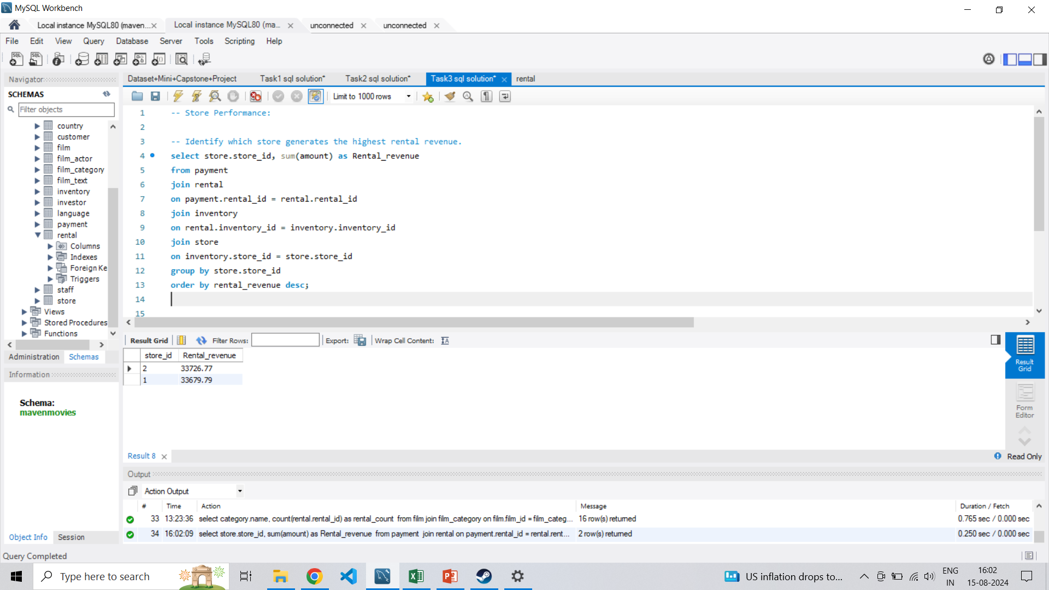
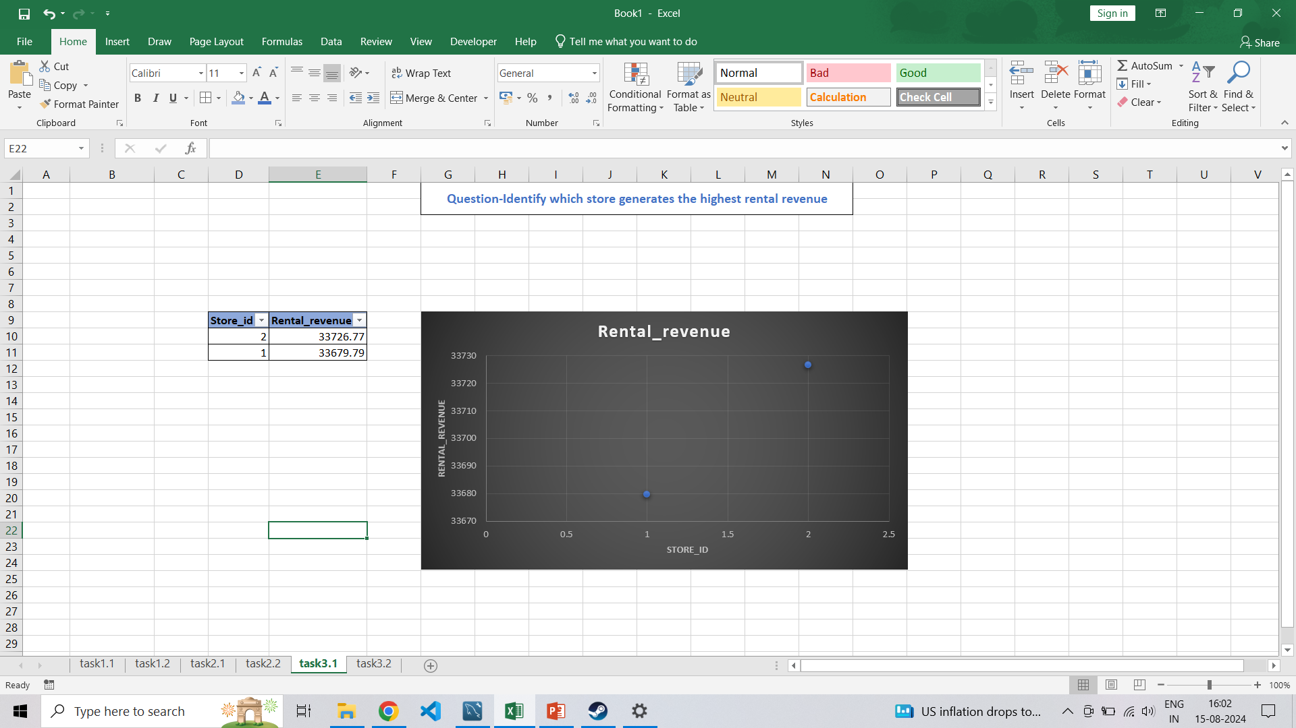
TASK 3.1 - Identify which store generates the highest rental revenue SQL QUERY VISUAL REPRESENTATION

Slide 14
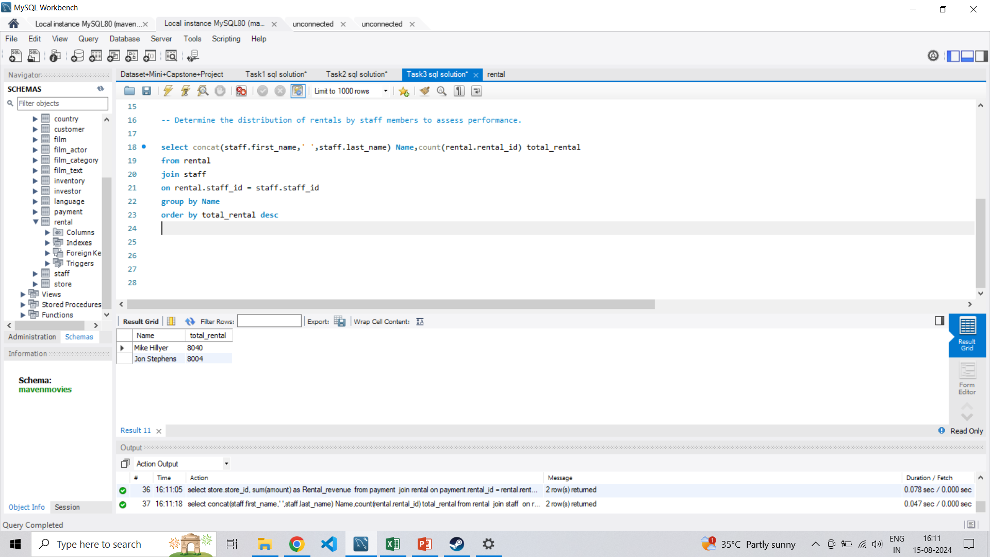
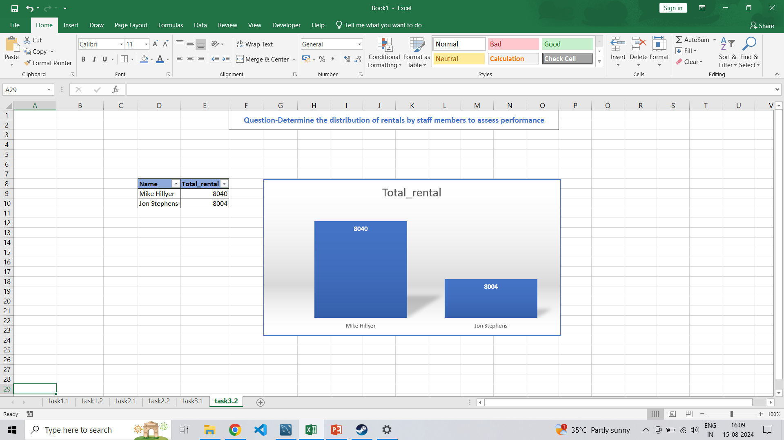
TASK 3.2 - Determine the distribution of rentals by staff members to assess performance SQL QUERY VISUAL REPRESENTATION

Slide 15
KEY FINDINGS
STAFF PERFORMANCE: MIKE HILLYER HAS THE HIGHEST TOTAL RENTALS AT 8040 AND JOHN STEPHENS IS CLOSE BEHIND WITH 8004 TOTAL RENTS. THE SMALL DIFFRENCE OF 36 RENTALS BETWEEN THE TWO STAFF MEMBERS INDICATING RELATIVELY BALANCED PERFORMANCE.
STORE REVENUE: STORE 2 GENERATES THE HIGHEST RENTAL REVENUE OF 33726.77 WHERE STORE 1 HAS A SLIGHTLY LOWER RENTAL REVENUE OF 33679.79

Slide 16
CONCLUSION
IN CONCLUSION, THIS PROJECT SUCCESSFULLY UTLILIZED SQL TO EXTRACT DATA, WHICH WAS THEN VISUALISED IN EXCEL. THIS PROCESS TRANSFORMED RAW DATA INTO CLEAR INSIGHTS,MAKING IT EASIER FOR STAKEHOLDERS TO UNDERSTAND AND ACT ON THE INFORMATION

Slide 17
THANK YOU!!

